Slide 1
Design space of computing metric distribution
Hang Shi
Huawei
IETF 116

Slide 2
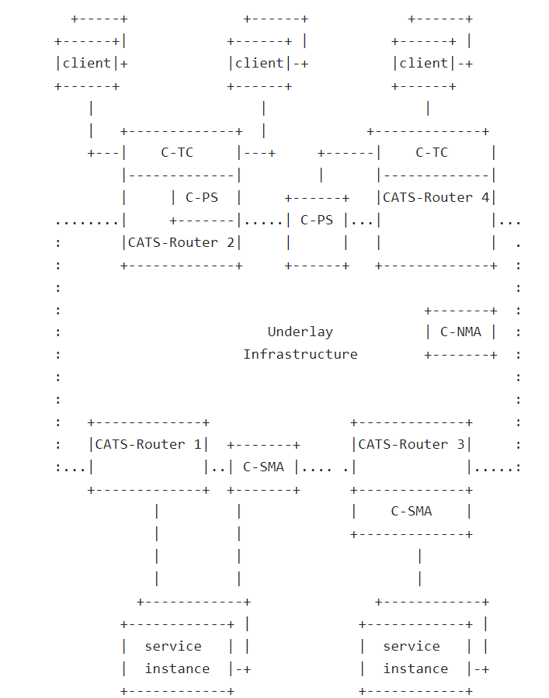
Recap of the CATS framework
Core functional components:
C-SMA: CATS Service Metric Agent
C-PS: CATS Path Selector
SMA collect the computing metric and distribute it to PS to make optimal path decision.
Design choice regarding:
How to collect
How to distribute

Slide 3
2x2 matrix of the design space
Two ways of collecting computing metric
Centralized: by a cloud monitor
Distributed: by CATS egress router
Two ways of distributing computing metric
Centralized: by network controller: calculate the path based on metric and distribute the result to ingress router
Distributed: each ingress router receive the computing metric and calculate the path by themselves.
Metric distribution | Centralized C-SMA | Distributed C-SMA
Centralized C-PS | Cloud monitor -> Controller | Egress -> Controller
Distributed C-PS | Cloud monitor -> Controller -> Ingress | Egress -> Controller -> Ingress

Slide 4
Example of centralized C-SMA +
Option 1: Centralized C-PS
Network controller calculates the path
No protocol extension needed
Option 2: Distributed C-PS
Network controller only pass the metric to Ingress (may involve pre-process)
Southbound protocol extension to distribute the metric
C-PS
C-SMA
C-SMA
Network
Controller
Cloud
Monitor
Network
Controller
Cloud
Monitor
Metric
Metric
Metric
Metric
Site 1
Metric
Site 1
Path
Egress
Egress
C-PS
Ingress
Ingress
Egress
Site 2
Site 2
Egress

Slide 5
Example of distributed C-SMA +
Option 3: Centralized C-PS
Network controller calculate the path
Southbound protocol extension to collect the metric. E.g. BGP-LS
Option 4: Distributed C-PS
Network controller only reflect the Metric (may involve pre-processing)
Southbound protocol extension to distribute the metric. E.g. BGP, BGP-LS, BGP flowspec
C-PS
Network
Controller
Network
Controller
C-SMA
Metric
C-SMA
Metric
Egress
Site 1
Egress
Site 1
Path
C-PS
Ingress
Ingress
Egress
Site 2
Egress
Site 2

Slide 6
Initial Comparation
 | Centralized C-SMA + Centralized C-PS | Centralized C-SMA + Distributed C-PS | Distributed C-SMA + Centralized C-PS | Distributed C-SMA + Distributed C-PS
Protocol extension choice | None | BGP flowspec | BGP-LS | BGP/BGP-LS, BGP flowspec
CATS router performance requirement | Low | High | Low | High
Network controller performance requirement | High | Low | High | Low
Comments and Questions?
Co-author/collaborator?

